Slide 1
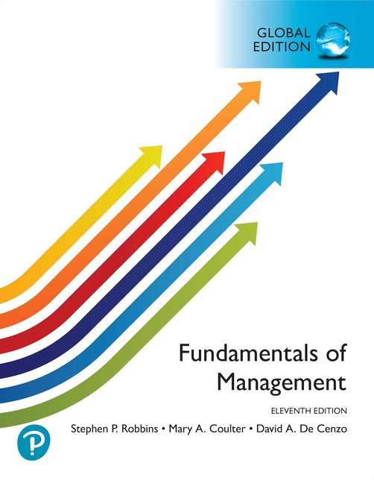
現代管理學 ch1 管理者與管理
1-<number>

Slide 2
1
Today's Management

Slide 3
Learning Objectives
Identify who managers are and where they work.
Define what management entails.
Describe the duties of a manager.
Explain why studying management is important.
Outline factors that reshape and redefine management.
現代管理學 ch1 管理者與管理
1-<number>

Slide 4
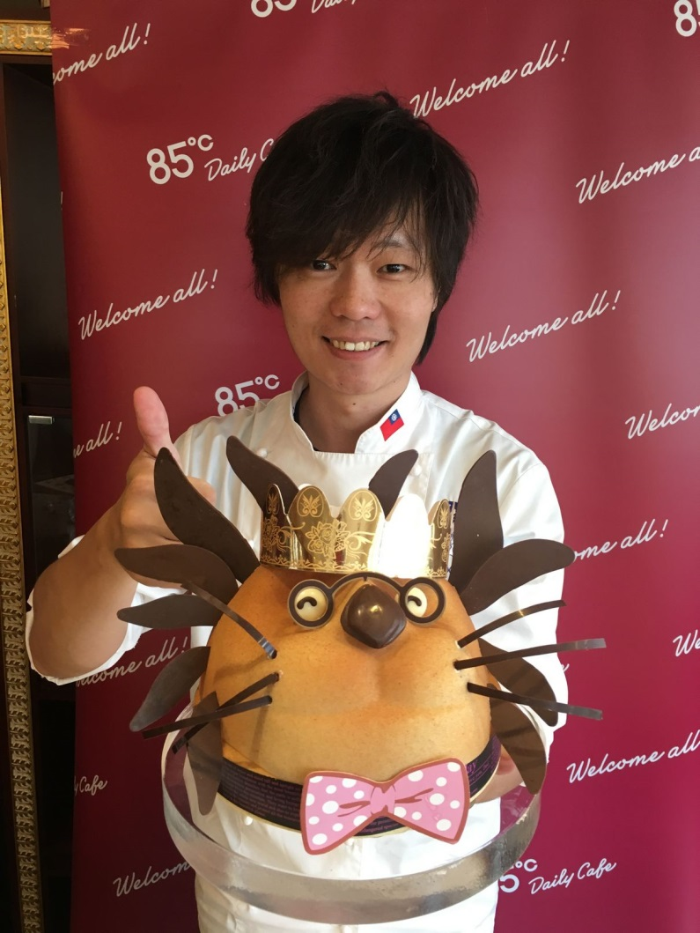
The 85°C Coffee Story(85度C的經營故事 )
85度C每月皆開發新口味以滿足消費者的需求，進而激發消費者的再購意願。吳政學也開放員工認股，讓員工對公司更有向心力。

Slide 5




Who are managers and where do they work?
Managers operate within an organizational context 。
organization(組織)
  A arrangement of personnel to achieve specific objectives
產銷人發財
  Production, Marketing, Human Resources, R&D, Finance
  生產, 行銷, 人力資源, 研發,財務
1-<number>

Slide 6
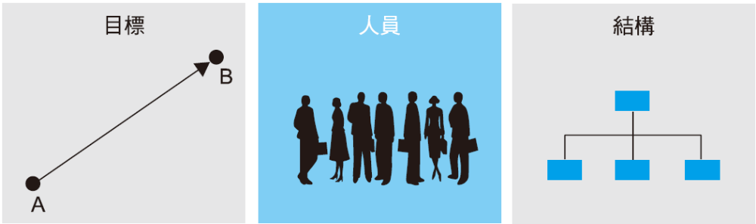
Who are managers and where do they work?
Organizational Characteristics
圖表1.1 組織的三個特徵
1-<number>

Slide 7
Three Common Features of Organizations
A unique purpose, often expressed as a single goal or set of goals.
These goals are achieved through the people within the organization.
The organization is structured in a particular way, and this specific structure simultaneously defines and constrains the behavior of its members.
1-<number>

Slide 8
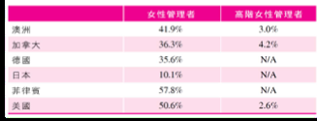
How do managers differ from nonmanagerial employees?
Organizational members fall into two categories：
  nonmanagerial employees(非管理職員工)
  managers (管理者)
1-<number>

Slide 9
How do managers differ from nonmanagerial employees?
Nonmanagerial employees
  For example, a cashier at a supermarket checkout.
managers (管理者)
  Individuals who achieve organizational goals by coordinating others' efforts
  Assist others in performing work協助他人進行工作。
This distinction does not imply managers never perform tasks directly.
1-<number>

Slide 10
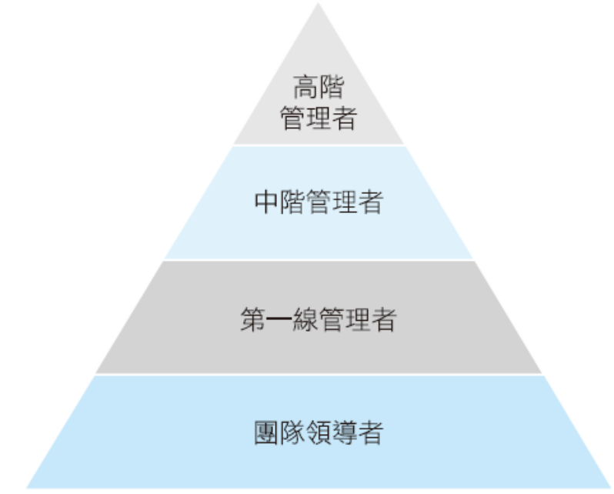
What are the titles of managers?
They are categorized as top, middle, and front-line managers, or team leaders.
Management Levels
1-<number>

Slide 11
What are the titles of managers?
Top managers(高階管理者),
  The highest-level managers in an organization 。
  副總經理(vice president)、總經理(president)、校長(chancellor)、執行董事(managing director)、營運長(chief operating officer)、執行長(chief executive officer CEO) 或董事長(chairperson of the board) 的職稱。
They formulate comprehensive organizational decisions and determine the organization's plans and objectives.
1-<number>

Slide 12
What is the title of the manager?
Middle managers (中階管理者)
  Managers positioned between the lowest and highest levels.
  部門經理或局長(department or agency head)、專案領導者(project leader)、單位主管(unit chief)、地區經理(district manager)、事業部經理(division manager)、店經理(store manager) 的職稱。
  Serve as a bridge, receiving corporate-level objectives, translating them into business unit goals, integrating plans from their unit or department, and submitting them to senior management for review.
Manage front-line supervisors(基層管理者).
1-<number>

Slide 13
What are the titles of managers?
first-line managers(第一線管理者)
  Direct the daily operations of non-managerial staff
  領班(supervisors)、組長(shift managers)、課長(office managers)、部門經理(department managers) 或單位協調者(unit coordinators)。
Responsible for managing frontline employees (基層員工).
現代管理學 ch1 管理者與管理
1-<number>

Slide 14
What is management?
The process of coordinating work items to ensure tasks are completed efficiently and effectively.
process (過程)
  It is a series of continuous and interrelated activities.
Efficiency (效率) and effectiveness (效能) are how things are done and how well they are accomplished.
Efficiency means doing things right, achieving maximum output with minimal input.
1-<number>

Slide 15
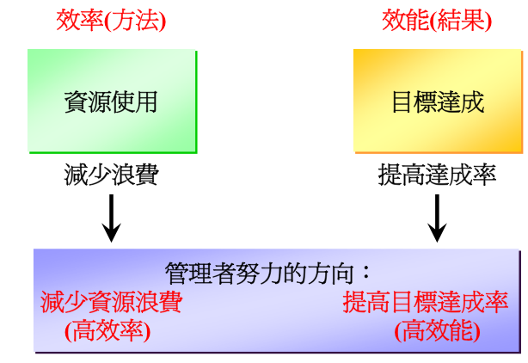
1-<number>

Slide 16
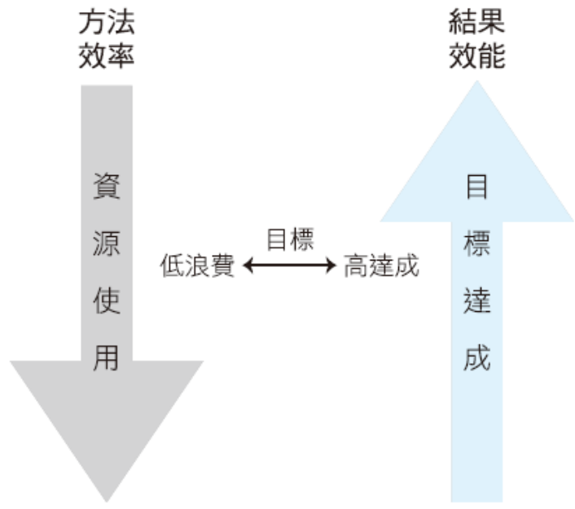
Effectiveness is the doing the right things, Achieving organizational goals.
1-<number>

Slide 17
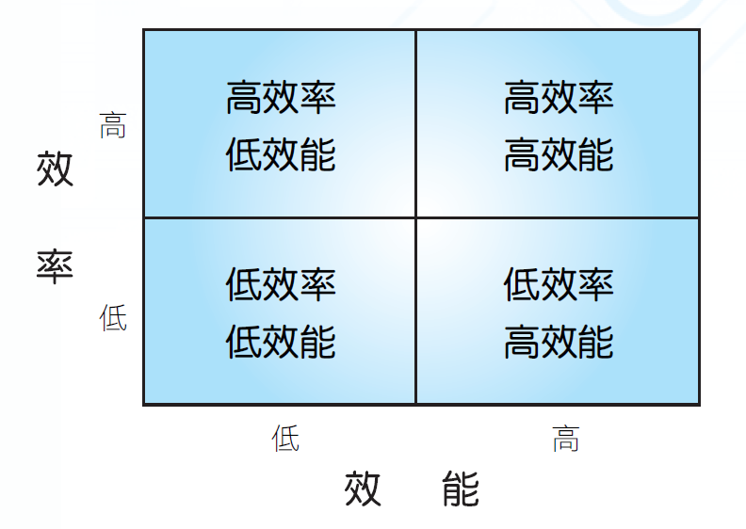
Which is the most terrifying!
1-<number>

Slide 18

Observe what managers are doing
Through the management functions
Henry Fayol (亨利費堯)
  plan(規劃)、organize (組織)、command (命令)、coordinate (協調) 與control (控制)
Today, management functions have been condensed into four items
  planning (規劃)、organizing (組織)、leading (領導) 與controlling (控制)。
This forms a cyclical sequence of planning, organizing, leading, and controlling, hence termed the management cycle.
› Innovation is sometimes added as a sixth function.
1-<number>

Slide 19
Management Functions
Planning(規劃)
  Setting objectives, formulating strategies, and developing systematic plans to integrate and coordinate all organizational activities.
Organizing(組織)
  Arranging personnel and tasks to achieve organizational objectives.
Leading(領導)
  Guiding people within the organization to accomplish organizational goals.
Controlling(控制)
  Monitoring and evaluating organizational performance, comparing actual results against predetermined objectives
1-<number>

Slide 20
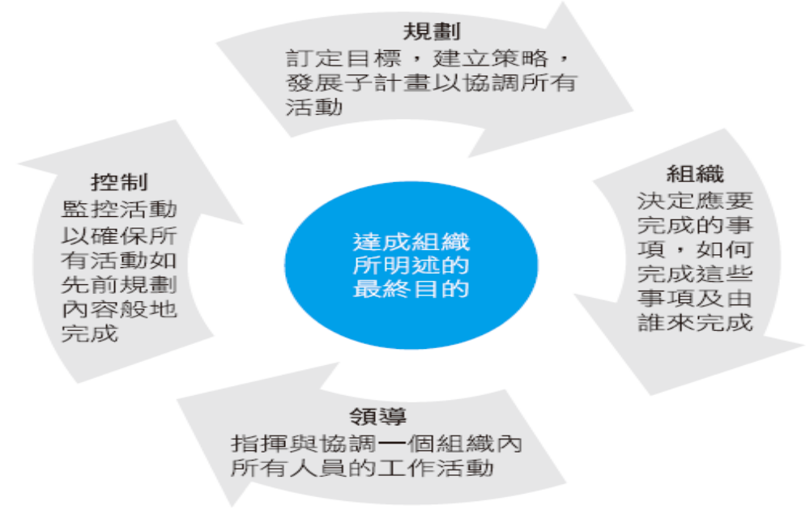
What Managers Do!
Four Management Functions
現代管理學 ch1 管理者與管理
1-<number>

Slide 21

What Managers Do!
Henry Mintzberg (明茲伯格)
  Based on managerial roles(管理角色). Defines specific actions or behaviors expected of managers through categories of management activities or anticipated behaviors.
  The ten roles, though distinct, are interrelated.
  Three categories: interpersonal relations(人際關係), information flow(資訊傳遞), and decision-making(制定決策).
現代管理學 ch1 管理者與管理
1-<number>

Slide 22
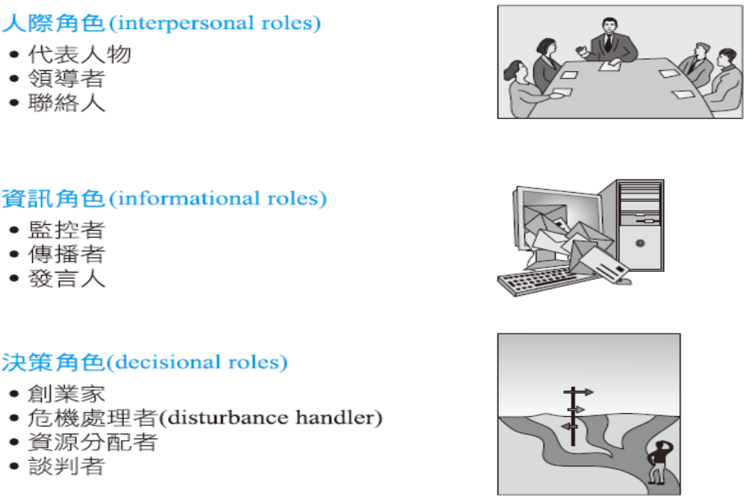
管理者在做的事 What Managers Do
Mintzberg's Classification of Managerial Roles
1-<number>

Slide 23

What Managers Do
Four Management Skills and Competencies (as proposed by Robert L. Katz and others):
  Conceptual Ability(概念化能力)
    Abstracting or conceptualizing complex situations
  Interpersonal Ability(人際關係能力)
    Working effectively with others or teams through communication, motivation, coaching, and delegation
  Technical Competence(技術能力)
    Mastering specific professional knowledge and skills
  Political Skills(政治技能)
    Building a power base and establishing the right connections to secure resources needed by the group
1-<number>

Slide 24
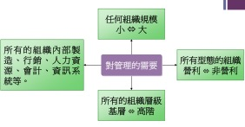
Universality(普遍性) of Management
  All enterprises require management
  If you are not a manager, you are an employee being managed
1-<number>

Slide 25
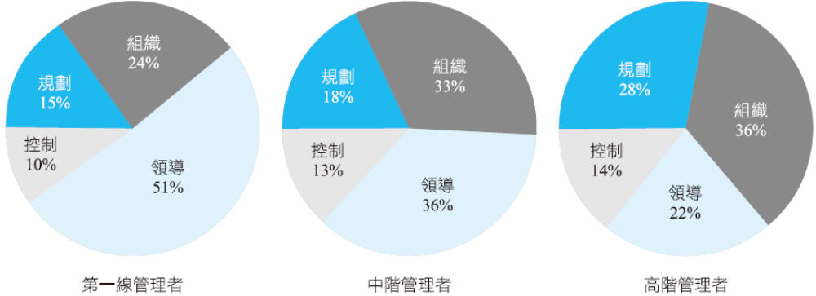

Is a Manager's Job Universally Applicable?
Distribution of Management Activities Across Organizational Levels
1-<number>

Slide 26
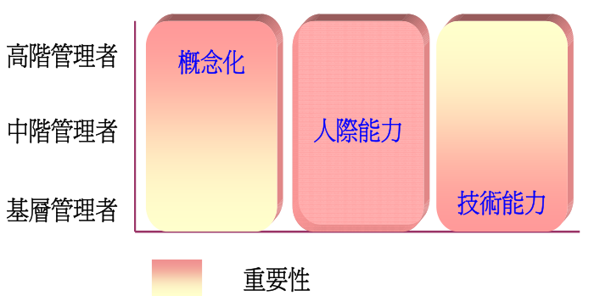
Is the Manager's Job Universally Applicable?
Organizational Levels(組織的層級)
  As managers advance, they increasingly focus on planning tasks while directly supervising others less frequently.
  The management activities changes with organizational level
1-<number>

Slide 27
Is the Manager's Job Universally Applicable?
For-Profit vs. Non-Profit
  The answer is largely the same
  Making decisions(制定決策), setting goals(設定目標), creating a functional organizational structure(組織結構), hiring and motivating employees, maintaining the organization's legitimacy(合理性), and developing internal political support(政治支援) to advance plans.
The most significant difference lies in how performance is measured.
1-<number>

Slide 28
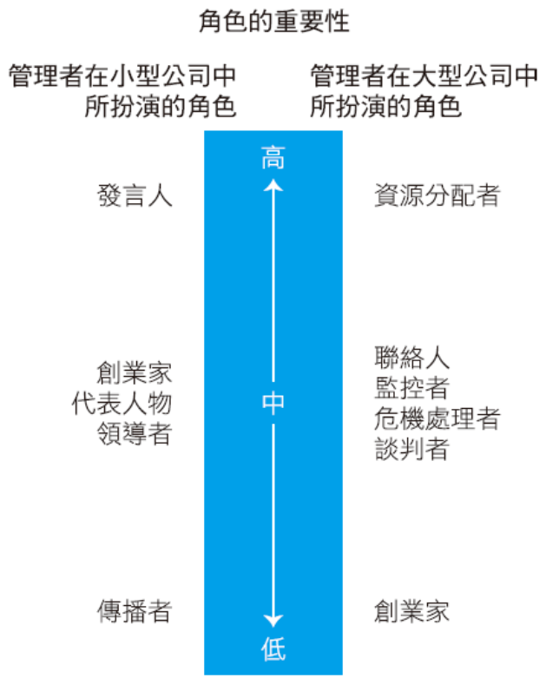
Is the work of a manager universally applicable?
Organizational Size(組織規模)
  Are small businesses different from large ones? Yes, certain differences do exist.
  Managers in large organizations primarily focus on determining which internal units receive resources and how much they receive
In contrast, managers in small businesses are more likely to be generalists(通才).
Managerial Roles in Small and Large Enterprises
1-<number>

Slide 29
Is the Manager's Job Universally Applicable?
Management Concepts and National Boundaries
  To date, there remains limited universal support for the generality of management concepts.
  Most concepts discussed in subsequent chapters primarily apply to the United States, Canada, the United Kingdom, Australia, and other English-speaking democratic nations democracies
  Managers applying these concepts in India, China, Chile, or other nations with political, economic, social, or cultural systems markedly different from so-called free-market democracies may need to modify certain management concepts.
1-<number>

Slide 30
What factors are reshaping management?
In today's world
  A changing workplace職場
  A shifting labor market勞動市場
Global economic and political uncertainty, and evolving technology(變動的科技)
influence how managers plan, organize, lead, and control.
Customers, innovation, social media, and sustainability(永續) are increasingly important for organizations and managers everywhere
現代管理學 ch1 管理者與管理
1-<number>

Slide 31
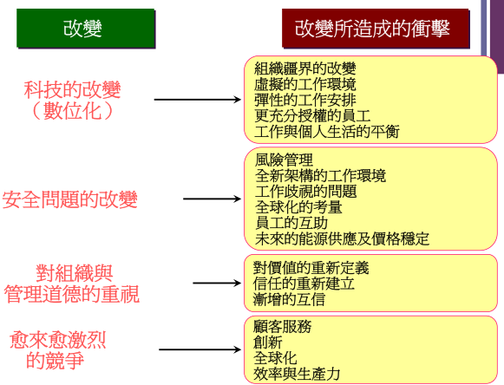
1-<number>

Slide 32

Why are customers important to managers?
The Importance of Customers
  Customer satisfaction(顧客滿意度) plays a vital role
  Consistent, high-quality customer service is key to survival and success, and employees are crucial in delivering it
1-<number>

Slide 33
Is innovation important to managers' work?
The Importance of Innovation
  New work methods, new products, or venturing into new domains(領域)
  Innovation means doing things differently, exploring new frontiers, and taking risks.
現代管理學 ch1 管理者與管理
1-<number>

Slide 34
Is social media important for managers?
Social Media(社群媒體)
  A form of electronic communication that creates online communities for sharing ideas, information, personal messages, and other content
  Employees utilize these platforms not only during personal time but also for work purposes. This is why managers must comprehend and manage the power and dangers of social media
1-<number>

Slide 35


  Beyond serving as a means to connect with customers, it also functions as a tool for managing human resources and channeling their innovation and talents.
  However, the potential danger of social media lies in how it is used
    When it becomes a platform for employees to boast(誇耀)about their achievements(成就)
    managers to send one-way messages (單向訊息) to employees
    or employees to complain about jobs or colleagues they dislike,
it loses its usefulness,
To avoid potential risks, managers must remember that social media is a tool that requires management to deliver its benefits
1-<number>

Slide 36
The Importance of Sustainability in Management
The 21st century has seen the rise of the concept of managing in a sustainable manner(永續性方式).
Sustainability(永續性)
  According to the World Business Council for Sustainable Development (2005), it is fundamentally concerned with “meeting the needs of the present without compromising the ability of future generations to meet their own needs.”
From a corporate perspective, sustainability has been defined as a company's ability to integrate economic, environmental, and social opportunities into its business strategy to achieve its objectives and enhance long-term shareholder value.
1-<number>

